Slide 2
What is the HWEI?
National benchmarking instrument for LGBTQ inclusive service provision in Australia
Evidence-based instrument that assesses each submission against a comprehensive rubric, enabling the determination of current, shifting and leading practice annually
Provide clear guidelines in getting started with or progressing work in LGBTQ inclusive service provision for both staff (within their agencies) and service users, regardless of how they identify
Tool for service providers to measure progress on internal initiatives validated by external, independent and confidential assessment
Tool for service providers to benchmark work against industry, sector and other service providers within the same tier
Valuable input into strategy and planning
Developed and assessed by Australia’s not-for-profit organisational support program for LGBTQ-inclusion

Slide 3
2022 HWEI: 100-point index
Section 1: Strategy, Development, Service Planning & Provision | 24 pts | Includes LGBTQ strategy and implementation in services; support networks and more.
Section 2: Continuous Improvement | 8 pts | Includes policy and practice to plan and monitor inclusion to ensure cultural safety and staff compliance to policy and practice standards
Section 3: Visibility of LGBTQ Inclusion | 10 pts | Includes LGBTQ visibility and inclusion across promotional materials, websites and brochures
Section 4: Initial Engagement & Assessment | 10 pts | Includes LGBTQ inclusive language on required forms and documents for services
Section 5: LGBTQ Inclusivity & Disclosure Training/Resources | 20 pts | Includes general development opportunities; training programs delivered on LGBTQ inclusion, access to best practice resources and more.
Section 6: Referrals & Stakeholder Management | 8 pts | Include referrals to other providers and engagement on inclusion matters with other professionals
Section 7: LGBTQ Community Engagement | 10 pts | Includes how you let the LGBTQ community know of your services, and how you collect and act on their feedback.
Section 8: Survey Participation | 2 pts | Participation in the HWEI staff survey
Section 9: Additional Work | 8 pts | Includes any work in LGBTQ inclusive work during the calendar year not claimed in other sections

Slide 4
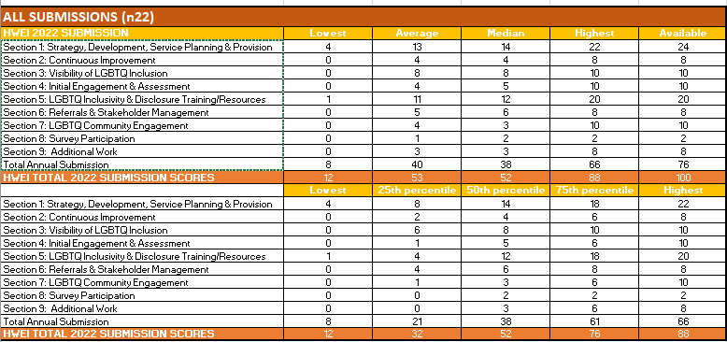
HWEI Benchmark: All Submissions
 | OUR SCORE
Section 1
Section 2
Section 3
Section 4
Section 5
Section 6
Section 7
Section 8
Section 9
Top Organisations:
cohealth
Uniting Vic.Tas
Advanced Diversity Services
Network of Alcohol and other Drugs Agencies (NADA)
WAYSS

Slide 5
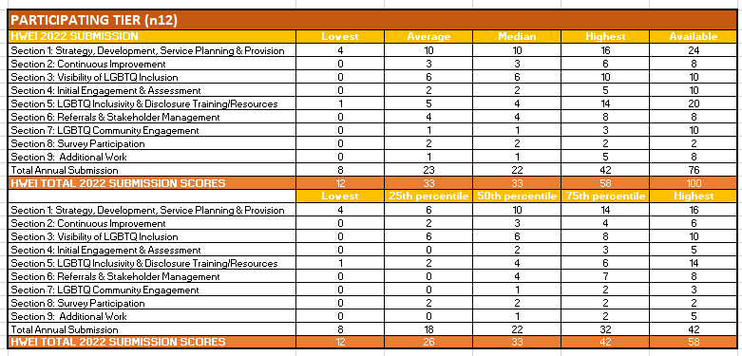
HWEI Benchmark: Participating Award

Slide 6
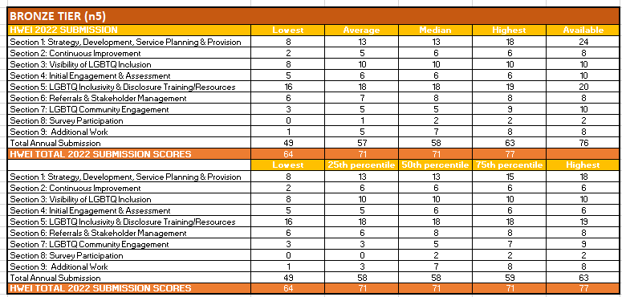
HWEI Benchmark: Bronze Award

Slide 7
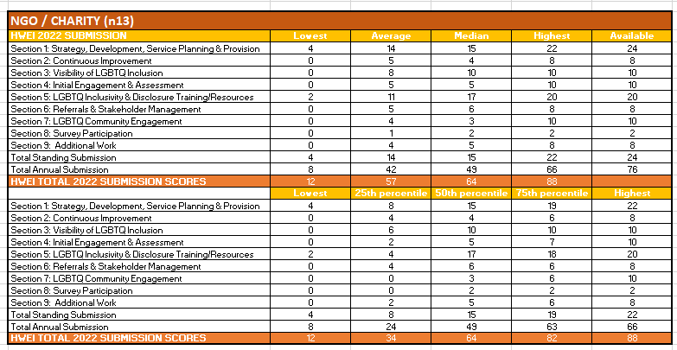
HWEI Benchmark: NGO/Charity
 | OUR SCORE
Section 1
Section 2
Section 3
Section 4
Section 5
Section 6
Section 7
Section 8
Section 9
Top Organisations:
cohealth
Uniting Vic.Tas
Advanced Diversity Services
Network of Alcohol and other Drugs Agencies

Slide 8
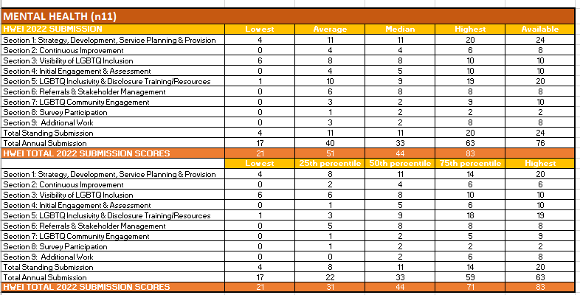
HWEI Benchmark: Mental Health
 | OUR SCORE
Section 1
Section 2
Section 3
Section 4
Section 5
Section 6
Section 7
Section 8
Section 9
Top Organisations:
Advanced Diversity Services
Relationships Australia (NSW)
St Vincent's Hospital Network
ACAP

Slide 9
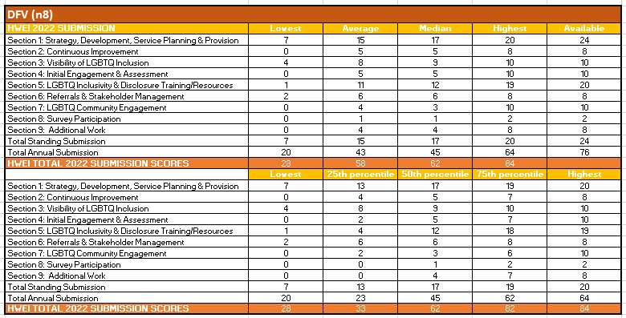
HWEI Benchmark: DFV
 | OUR SCORE
Section 1
Section 2
Section 3
Section 4
Section 5
Section 6
Section 7
Section 8
Section 9
Top Organisations:
Uniting Vic.Tas
Advanced Diversity Services
WAYSS

Slide 10
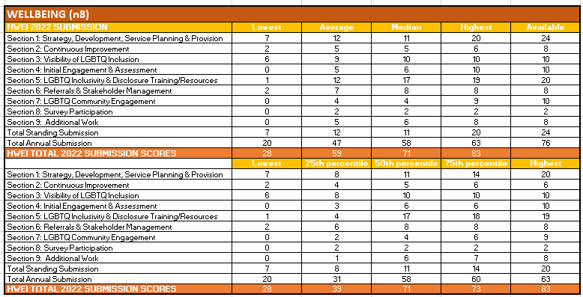
HWEI Benchmark: Wellbeing
 | OUR SCORE
Section 1
Section 2
Section 3
Section 4
Section 5
Section 6
Section 7
Section 8
Section 9
Top Organisations:
Advanced Diversity Services
Relationships Australia (NSW)
St Vincent's Hospital network
City Fertility
ACAP

Slide 11
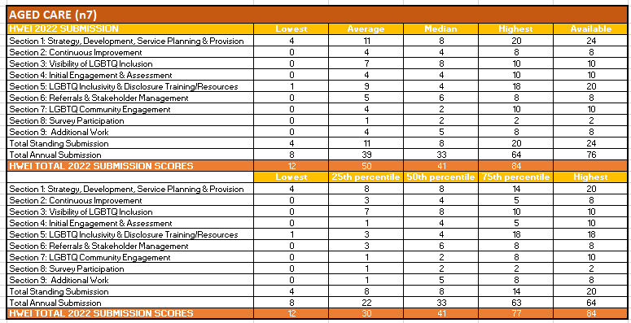
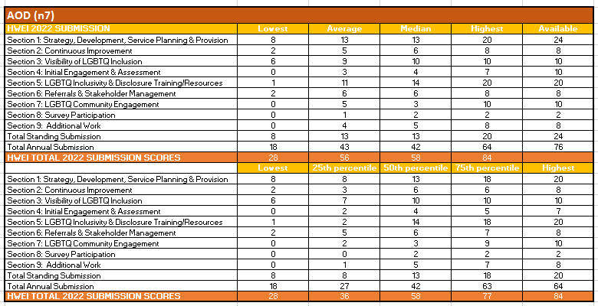
HWEI Benchmark: Aged Care & Home Nursing
 | OUR SCORE
Section 1
Section 2
Section 3
Section 4
Section 5
Section 6
Section 7
Section 8
Section 9
Top Organisations:
Uniting Vic.Tas
Advanced Diversity Services
St Vincent's Hospital network

Slide 12
HWEI Benchmark: AOD
 | OUR SCORE
Section 1
Section 2
Section 3
Section 4
Section 5
Section 6
Section 7
Section 8
Section 9
Top Organisations:
Uniting Vic.Tas
Network of Alcohol and other Drugs Agencies
St Vincent's Hospital network

Slide 13
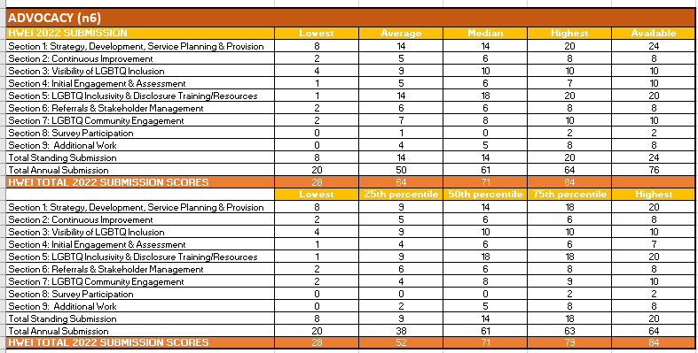
HWEI Benchmark: Advocacy
 | OUR SCORE
Section 1
Section 2
Section 3
Section 4
Section 5
Section 6
Section 7
Section 8
Section 9
Top Organisations:
Uniting Vic.Tas
Network of Alcohol and other Drugs Agencies
St Vincent's Hospital network
ACAP

Slide 14
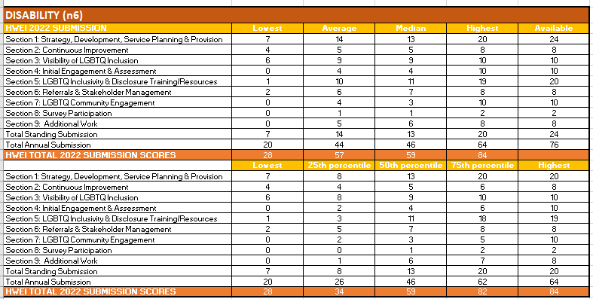
HWEI Benchmark: Disability & Support
 | OUR SCORE
Section 1
Section 2
Section 3
Section 4
Section 5
Section 6
Section 7
Section 8
Section 9
Top Organisations:
Uniting Vic.Tas
Advanced Diversity Services
Relationships Australia (NSW)

Slide 15
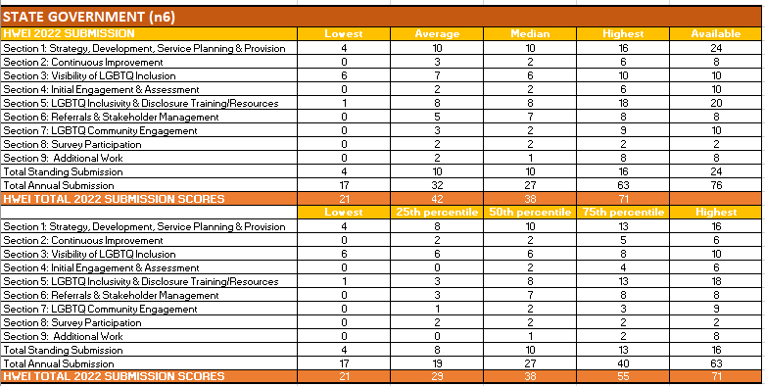
HWEI Benchmark: State Government
 | OUR SCORE
Section 1
Section 2
Section 3
Section 4
Section 5
Section 6
Section 7
Section 8
Section 9
Top Organisations:
St Vincent's Hospital network
Illawarra Shoalhaven LHD H&A &HARP Units

